Slide 1



Whats up with AI?

Slide 2
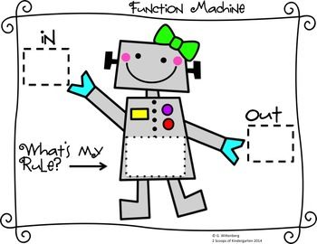
Functions
CS 106B
Lecture 1
Jan 4, 2015

Slide 3
Announcements
Monday QT Creator help with Megan!
Chris office hours are moved to Friday 2:30pm to 3:30pm
You can start Life now. Due Jan 15th
I would recommend getting QT creator installed on your computer.

Slide 4

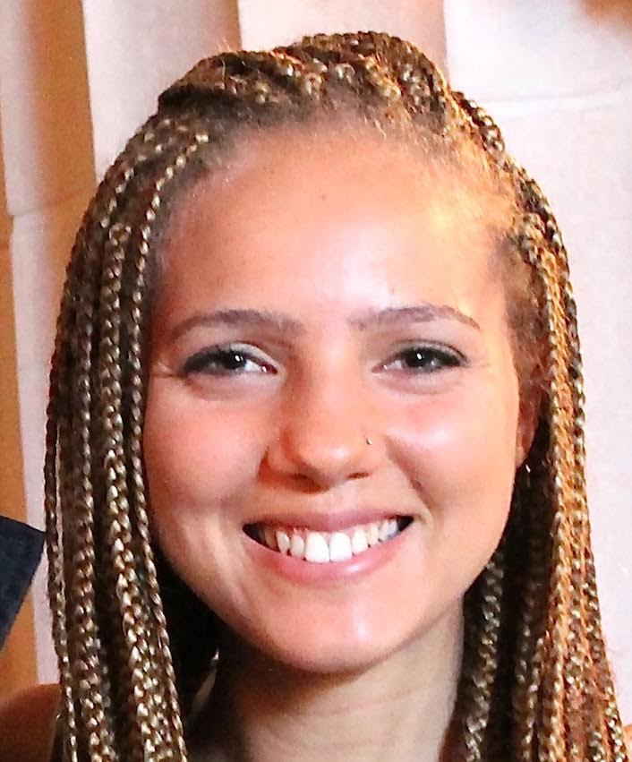
Course Staff
Instructor: Chris Piech
Office hours:
Mon 1:30 to 2:30pm
Wed 2:30 to 3:30pm
Head TA: Megan Faulk
Office hours:
Tue, Th 9:00 to 10:30am

Slide 5
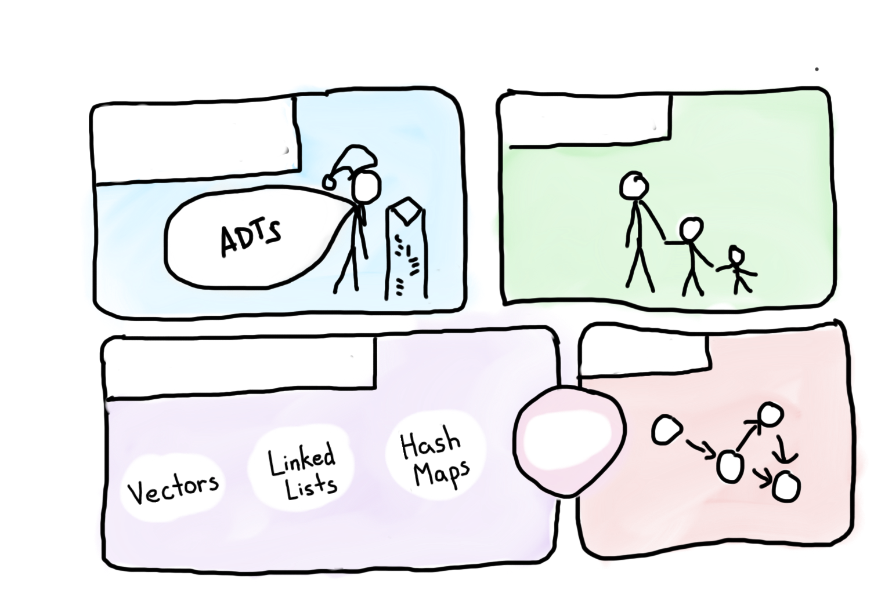
Course Syllabus
Intro to Abstractions
Recursion
Graphs
Under the Hood
Trees

Slide 6

Course Syllabus
Intro to Abstractions
Recursion
Graphs
Under the Hood
Trees
You are here

Slide 7

Today’s Goals
Intro to C++
C++ functions

Slide 8
Part 1: C++

Slide 9

Similar to Java
C++ from the Java Programmer’s Perspective
(But it’s ok if you don’t know java!)

Slide 10

Follow Along!
https://www.codechef.com/ide

Slide 11
Hello World
/*
* The canonical hello world program in C++
*/
#include <iostream> // A true classic.
#include "console.h" // A Stanford Library!
using namespace std; // The best namespace.
int main() {
cout << “hello, world!” << endl;
return 0;
}

Slide 12
Hello World
/*
* The canonical hello world program in C++
*/
#include <iostream> // A true classic.
#include "console.h" // A Stanford Library!
using namespace std; // The best namespace.
int main() {
cout << “hello, world!” << endl;
return 0;
}

Slide 13
Hello World
/*
* The canonical hello world program in C++
*/
#include <iostream> // A true classic.
#include "console.h" // A Stanford Library!
using namespace std; // The best namespace.
int main() {
cout << “hello, world!” << endl;
return 0;
}

Slide 14
Hello World
/*
* The canonical hello world program in C++
*/
#include <iostream> // A true classic.
#include "console.h" // A Stanford Library!
using namespace std; // The best namespace.
int main() {
cout << “hello, world!” << endl;
return 0;
}

Slide 15
Guessing Game!
Print out a welcome message
Generate a random secret number.
Until the end of time:
Get a guess from the user
If the guess is equal to secret, exit
Print if the guess is high or low

Slide 16
Part 2: Functions

Slide 17
A First C++ Function
#include <iostream>
#include "console.h"
using namespace std;
int main() {
cout << "|-5| = " << absoluteValue(-5) << endl;
return 0;
}
int absoluteValue(int n) {
if(n < 0) {
return -n;
}
return n;
}
You don’t know what automata is, do you? SOON!

Slide 18
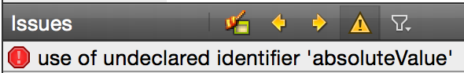
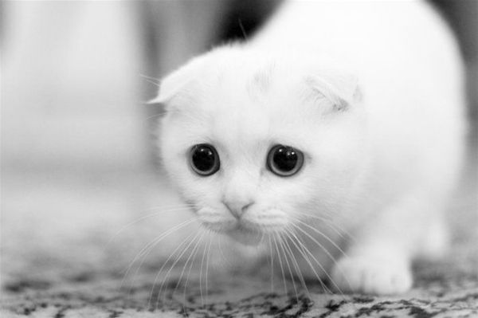
A First C++ Function (Error)
#include <iostream>
#include "console.h"
using namespace std;
int main() {
cout << "|-5| = " << absoluteValue(-5) << endl;
return 0;
}
int absoluteValue(int n) {
if(n < 0) {
return -n;
}
return n;
}
You don’t know what automata is, do you? SOON!

Slide 19
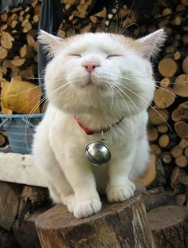
A First C++ Function (Fix 1)
#include <iostream>
#include "console.h"
using namespace std;
int absoluteValue(int n) {
if(n < 0) {
return -n;
}
return n;
}
int main() {
cout << "|-5| = " << absoluteValue(-5) << endl;
return 0;
}
You don’t know what automata is, do you? SOON!
Fix: Change order of functions

Slide 20
A First C++ Function (Fix 2)
#include <iostream>
#include "console.h"
using namespace std;
int absoluteValue(int n);
int main() {
cout << "|-5| = " << absoluteValue(-5) << endl;
return 0;
}
int absoluteValue(int n) {
if(n < 0) {
return -n;
}
return n;
}
Fix: Add a function “prototype”
You don’t know what automata is, do you? SOON!

Slide 21
Why does C++ have the function prototype syntax?
C++ Design?
In other words, why not just have a rule that you must set up the ordering so you define your functions before using them, as in the "FIX 1" example?
C++ could have done that, but such a rule would be too cumbersome for programmers to follow.
C++ could have done that, but good programming style dictates "top-down" approach that logically puts main() first and helper functions it calls to follow.
C++ could not have done that, because sometimes there is no way to order the functions so that all functions are defined before being used.
Other/none/more than one of the above
You don’t know what automata is, do you? SOON!

Slide 22
Points

Slide 23
Points
Prototype your functions

Slide 24
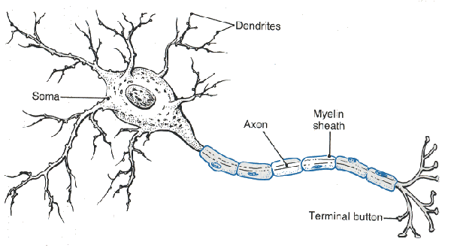
Lets Write a Function
You don’t know what automata is, do you? SOON!

Slide 25
Neuron

Slide 26
Neuron

Slide 27
Neuron

Slide 28
Neuron

Slide 29
Neuron

Slide 30
Some Inputs are More Important

Slide 31
Artificial Neuron
1
2
1
3
6
0.99
-2
0
1
1

Slide 32
Artificial Neuron
1
2
1
3
6
0.99
-2
0
1
1
InputSum = input1 * weight1 +
input2 * weight2 +
input3 * weight3 +
input4 * weight4

Slide 33
Artificial Neuron
1
2
1
3
6
0.99
-2
0
1
1
Input sum = 1 * 2 +
1 * 3 +
0 * -2 +
1 * 1

Slide 34
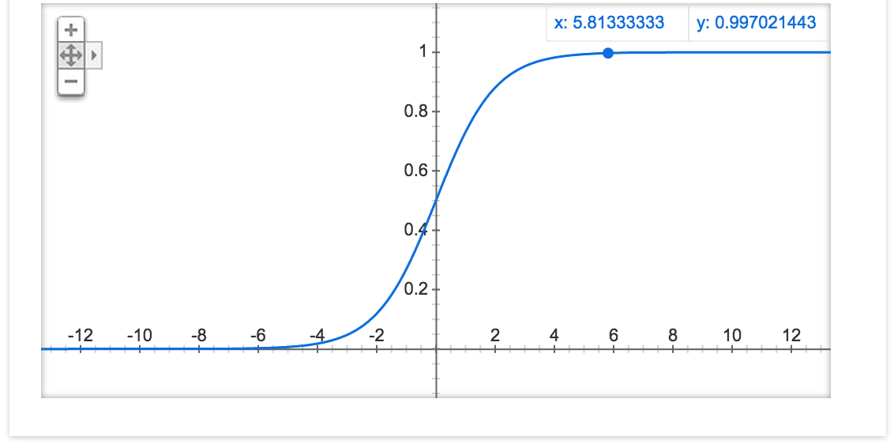
Sigmoid Function
1
2
1
3
6
0.99
-2
0
1
1

Slide 35
Artificial Neuron
1
2
1
3
6
0.99
-2
0
1
1
InputSum = input1 * weight1 +
input2 * weight2 +
input3 * weight3 +
input4 * weight4;
Output = sigmoid(InputSum);

Slide 36
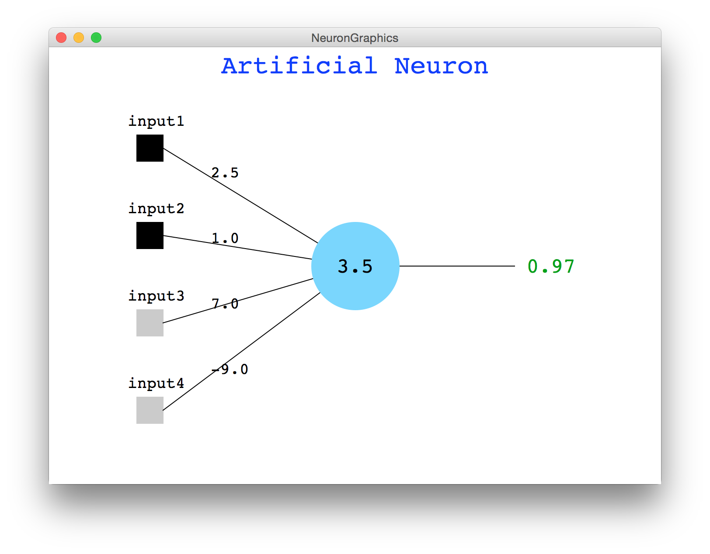
Artificial Neuron Demo

Slide 37
Lets Write a Function
You don’t know what automata is, do you? SOON!

Slide 38
Lets Write a Function
1
2
1
3
6
0.99
-2
0
1
1
InputSum = input1 * weight1 +
input2 * weight2 +
input3 * weight3 +
input4 * weight4;
Output = sigmoid(InputSum);
You don’t know what automata is, do you? SOON!

Slide 39
Pass by Value
value semantics: In Java and C++, when variables (int, double) are passed as parameters, their values are copied.
Modifying the parameter will not affect the variable passed in.
void grow(int age) {
age = age + 1;
cout << "grow age is " << age << endl;
}
int main() {
int age = 20;
cout << "main age is " << age << endl;
grow(age);
cout << "main age is " << age << endl;
return 0;
}
Output:
main age is 20
grow age is 21
main age is 20

Slide 40
Pass by Reference (2.5)
reference semantics: In C++, if you declare a parameter with an & after its type, instead of passing a copy of its value, it will link the caller and callee functions to the same variable in memory.
Modifying the parameter will affect the variable passed in.
void grow(int& age) {
age = age + 1;
cout << "grow age is " << age << endl;
}
int main() {
int age = 20;
cout << "main age is " << age << endl;
grow(age);
cout << "main age is " << age << endl;
return 0;
}
Output:
main age is 20
grow age is 21
main age is 21

Slide 41

Pass by Reference Example
With reference parameters, you can write a swap function.
/*
* Places a's value into b and vice versa.
*/
void swap(int& a, int& b) {
int temp = a;
a = b;
b = temp;
}

Slide 42
A Mystery
What is the output of this code?
void mystery(int& b, int c, int& a) {
b--;
a++;
c += a; // A. 4 2 9
} // B. 4 3 7
// C. 5 2 8
int main() { // D. 5 3 13
int a = 5; // E. other
int b = 2;
int c = 8;
mystery(a, b, c);
cout << a << " " << b << " " << c << endl;
return 0;
}
Notes:
Correct answer: B. 5 3 7

Slide 43
A Mystery
What is the output of this code?
void mystery(int& b, int c, int& a) {
b--;
a++;
c += a;
}
int main() {
int a = 5;
int b = 2;
int c = 8;
mystery(a, b, c);
cout << a << " " << b << " " << c << endl;
return 0;
}
Notes:
Correct answer: B. 5 3 7

Slide 44
A Mystery
What is the output of this code?
void mystery(int& b, int c, int& a) {
b--;
a++;
c += a;
}
int main() {
int a = 5;
int b = 2;
int c = 8;
mystery(a, b, c);
cout << a << " " << b << " " << c << endl;
return 0;
}
Notes:
Correct answer: B. 5 3 7

Slide 45
A Mystery
What is the output of this code?
void mystery(int& b, int c, int& a) {
b--;
a++;
c += a;
}
int main() {
int a = 5;
int b = 2;
int c = 8;
mystery(a, b, c);
cout << a << " " << b << " " << c << endl;
return 0;
}
b = 5
c = 2
a = 8
Notes:
Correct answer: B. 5 3 7

Slide 46
A Mystery
What is the output of this code?
void mystery(int& b, int c, int& a) {
b--;
a++;
c += a;
}
int main() {
int a = 5;
int b = 2;
int c = 8;
mystery(a, b, c);
cout << a << " " << b << " " << c << endl;
return 0;
}
b = 5
c = 2
a = 8
Now b = 4
Notes:
Correct answer: B. 5 3 7

Slide 47
A Mystery
What is the output of this code?
void mystery(int& b, int c, int& a) {
b--;
a++;
c += a;
}
int main() {
int a = 5;
int b = 2;
int c = 8;
mystery(a, b, c);
cout << a << " " << b << " " << c << endl;
return 0;
}
b = 5
c = 2
a = 8
Now b = 4
Now a = 9
Notes:
Correct answer: B. 5 3 7

Slide 48
A Mystery
What is the output of this code?
void mystery(int& b, int c, int& a) {
b--;
a++;
c += a;
}
int main() {
int a = 5;
int b = 2;
int c = 8;
mystery(a, b, c);
cout << a << " " << b << " " << c << endl;
return 0;
}
b = 5
c = 2
a = 8
Now b = 4
Now a = 9
Now c = 11
Notes:
Correct answer: B. 5 3 7

Slide 49
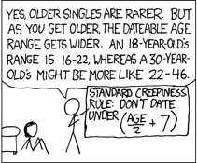
Output Parameters
What is the minimum and maximum non-creepy age to date?
void datingRange(int age, int& min, int& max) {
min = age / 2 + 7;
max = (age - 7) * 2;
}
int main() {
int young;
int old;
datingRange(48, young, old);
count << "A 48-year-old could date someone from "
<< young << " to " << old " years old." << endl;
}
// A 48-year-old could date someone from
// 31 to 82 years old.
http://xkcd.com/314/

Slide 50
Pass by Reference Pros / Cons
benefits of reference parameters:
a useful way to be able to 'return' more than one value
often used with objects, to avoid making bulky copies when passing
downsides of reference parameters:
hard to tell from call whether it is ref; can't tell if it will be changed
foo(a, b, c); // will foo change a, b, or c? :-/
(very) slightly slower than value parameters
can't pass a literal value to a ref parameter
grow(39); // error

Slide 51
Points
Prototype your functions
Pass by reference vs
pass by value

Slide 52
Today’s Goals
Intro to C++
C++ functions

Slide 53
Story of Modern AI

Slide 54
Whats up with AI?

Slide 55
Remember Me?

Slide 56
Put Many Together

Slide 57
Put Many Together

Slide 58
Put Many Together

Slide 59
Put Many Together

Slide 60

Google Brain
1 Trillion Artificial Neurons

Slide 61
Big Milestones

Slide 62
Put Many Together

Slide 63
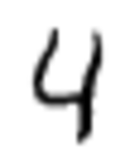
Make It Useful

Slide 64
Make It Useful

Slide 65
Make It Useful
This means it’s a picture of the number 4

Slide 66

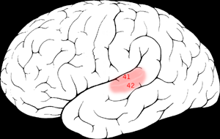

One Learning Algorithm
One Algorithm Hypothesis
Auditory Cortex
Auditory cortex learns to see
[Roe et al., 1992]
[Andrew Ng]

Slide 67
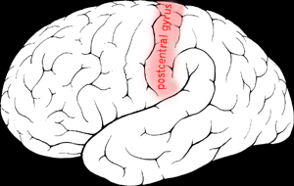

One Algorithm Hypothesis
Somatosensory Cortex
Somatosensory cortex learns to see
[Metin & Frost, 1989]
[Andrew Ng]

Slide 68
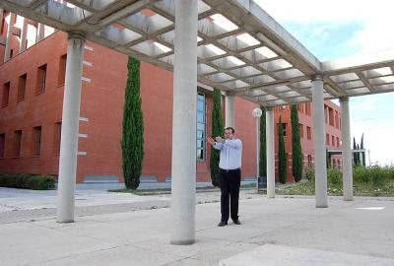
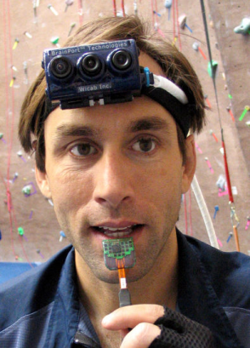
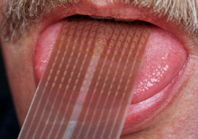
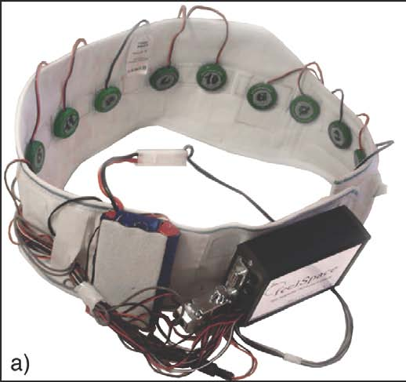
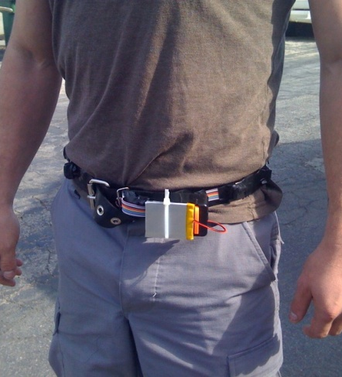
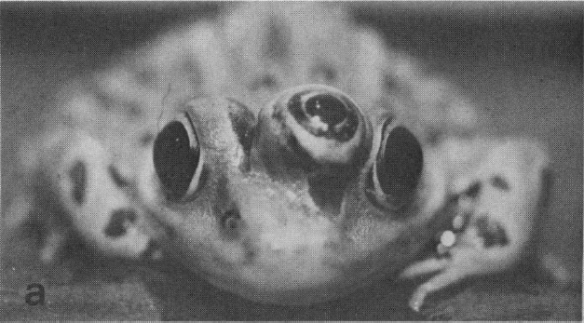
Sensor Representations
Seeing with your tongue
Human echolocation (sonar)
Haptic belt: Direction sense
Implanting a 3rd eye
[BrainPort; Welsh & Blasch, 1997; Nagel et al., 2005; Constantine-Paton & Law, 2009]

Slide 69

Know It So You Can Beat It
Little math

Slide 70
The End.

Slide 71
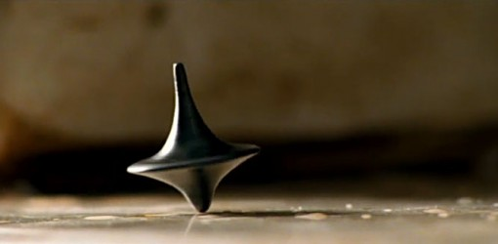
The End?

